Slide 1
Dual Homed Passive Optical Network (PON) Gateway The HLD is published and located at - https://github.com/sonic-net/SONiC/pull/2376
Presenter : Anurag Prakash (Ciena), Gerald Smallegange (Ciena)

Slide 2
Agenda
Brief Overview of PON
Physical Network Topology
SONiC/Dual ToR Concepts
Dual Homed PON Gateway Solution
Dual-ToR & Dual Homed PON: Parallel Architecture Strategy
High Level Architecture
PON Protection FSM
PON Protection Orchestrator
IPinIP Tunnel Programming
REDIS DB Architecture
Failover Sequence for OLT Fault
Traffic Shift Away (TSA)
Memory Footprints
How to test?
Troubleshooting
Q&A

Slide 3
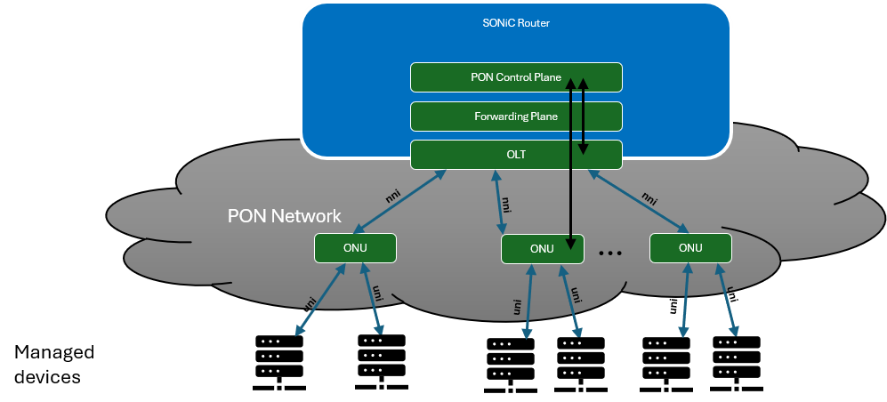
Brief Overview of PON
PON | Passive Optical Network.
OLT | Optical Line Terminal — the PON head-end device managed by this feature.
OLT Interface | An optical interface associated with an OLT, which is connected to a set of downstream ONUs.
OLT Plug | a micro-OLT (uOLT) — a small form factor optical plug that combines the OLT function and the OLT interface into one device.
ONU | Optical Network Unit — a PON subscriber-side endpoint.

Slide 4

Physical Network Topology
T1
T1
1. An OLT interface will be deployed on each of the Gateway Routers
The OLT Interface on Gateway-A will be in active mode. The associated Ethernet interface will be UP.
The OLT Interface on Gateway-B will be in standby mode. The associated Ethernet interface will be UP.
2. Gateway Configuration
Both OLT interfaces will have the same VLAN and Virtual MAC configuration.
Both Gateways will advertise the same IPv4, and/or IPv6 addresses associated with the OLT interfaces/VLAN interfaces to upstream routers.
Upstream routers will receive two available next hops to reach servers/devices.
3. Downstream Traffic (Gateway to Server/Device)
Upstream routers distribute traffic to both Gateway Routers.
Gateway-A with the Active OLT interface forwards all traffic to the downstream servers/devices directly over the OLT Interface.
Gateway-B with the standby OLT interface forwards all traffic destined to the downstream servers/devices using a IPinIP tunnel towards Gateway-A with the active OLT interface.
4. Upstream Traffic (Server/Device to OLT interface)
Servers send traffic upstream to the ONU.
The active OLT interface grants upstream timeslots to the ONUs
OLT interface in a standby by state will not grant upstream timeslots.
Upstream traffic from ONUs is therefore only received on the active OLT interface.
Down Stream
Traffic
Up Stream
Traffic
Gateway (G-A)
IPinIP Tunnel
Gateway (G-B)
OLT-A
Active
ODN
OLT-B
Standby
PON Fiber
Splitter
ONU-1
ONU-2
…
ONU-N
…
…
…
Device-1
Device-N
Device-1
Device-N
Device-1
Device-N

Slide 5
SONiC - Dual ToR Concepts
PON Dual Home Gateway leverages key concepts of the SONiC Architecture, the current Dual ToR solutions and incorporates the added advantages of leveraging a PON Active/Standby Transport to simplify the solution.
SONiC/Dual ToR concepts:
Mux Container:
Manages the hitless MUX hardware inside the smart Y-cable. It actively handles state convergence during failover conditions, dictating which ToR is active or standby for server connectivity
Linkmgrd continuously collects multiple underlying state metrics, including isthe physical Link state (Up/Down), the software link probing health (via ICMP heartbeats), and the actual hardware MUX state reported by the cable.
The ICMP probing function removed since PON interface state is provided directly from the OLT.
Orchestration Agent:
Coordinates the L3 tunnels established between the peered ToRs. It actively manages convergence by configuring Access Control Lists (ACLs) on the standby ToR and interacting with new SAI (Switch Abstraction Interface) APIs.
SwSS (Switch State Service) Container
Acts as the messaging hub coordinating communication between network apps, the Redis database engine, and the underlying Linux kernel
SyncD Container
Translates the switch state data from the central database (ASIC_DB) and pushes it to the physical hardware/ASIC via the Switch Abstraction Interface (SAI) to execute line-rate forwarding.
BGP (FRR) Container
Runs the routing stack. It handles control-plane routing, ensuring that upstream spine switches see both ToRs as valid, redundant next-hops to prevent network disruptions.
Database Container
In-memory Redis database that enables the core publisher/subscriber messaging paradigm across the NOS, keeping the containers decoupled yet perfectly synchronized.

Slide 6
Dual Homed PON Gateway Solution
Overview
The Dual Homed PON solution will support the Active/Standby topology.
A new pon-orch agent will be introduced to support a Dual Homed PON solution.
A new daemon pon-protd is introduced that is the authority for PON forwarding decisions.
pon-protd is created for PON semantics with a dedicated FSM-driven architecture.
The state machine uses Port, OLT Interface states to derive composite state as input to the pon-orch agent.
PON Fault detection and notification will be provided by the PON SAI.
Prober functions in existing Dual ToR features which leverage ICMP are not needed for the PON solution and are thus removed.
Directly Connected
Traffic that arrives on Router with Active PON send traffic directly over PON Interface.
SONiC
IPinIP Tunnel
Traffic from Standby PON Interfaces is transported to active PON interface via the IPinIP tunnel
PON
SyncD
Active OLT Interface
IP
IP
Router
IP
Device-1
…
ONU-1
IP
IP
Device-N
OLT Interface Active
IP
…
Router A
Device-1
ECMP
ECMP forwards host management traffic to both Router A and Router B.
…
ONU-2
Splitter
Network
Device-N
…
IP
OLT Interface Standby
IP
IP
…
Device-1
Router B
…
ONU-N
IPinIP tunnel
Traffic redirected over IPinIP tunnel when PON is in standby state.
Device-N

Slide 7
Dual-ToR & Dual Homed PON: Parallel Architecture Strategy
The Dual-Homed PON Gateway is delivered as a parallel, self-contained solution alongside the existing SONiC Dual-ToR implementation, rather than extending Dual-ToR itself. The rationale is to contain complexity and minimize changes to existing functionality in production:
Contains complexity - PON protection logic lives in its own FSM and orchestrator, so the Dual-ToR state machine does not acquire PON-specific branches and conditions.
Avoids regression risk - No changes are made to the Dual-ToR FSM or data path, so existing Dual-ToR deployments carry no regression exposure from PON work.
Limits blast radius - A defect or change in the PON path only affects PON-connected subscribers; Dual-ToR failover behaviour is untouched.
Different detection model - Dual-ToR failover is driven by ICMP probing between ToRs, which does not apply to PON; PON protection is triggered by OLT and PON fault events. Merging PON with Dual ToR would force two unrelated detection models into one FSM.
Scoped by design - The solution is purpose-built for PON deployments and is not a general Dual-ToR replacement, so it should not inherit Dual-ToR's general-purpose requirements.
Preserves open-source testability - Upstream contributors cannot validate PON behaviour without physical OLT hardware/simulation; separation keeps Dual-ToR fully testable by the community.
Independent delivery - Each solution can be developed, tested and released on its own cadence, with a smaller and clearer test matrix for both.

Slide 8
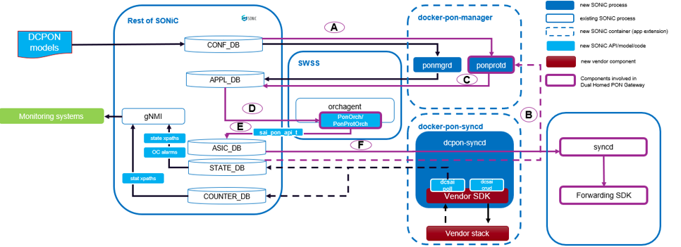
High Level Architecture
Legend - callouts 1-3 in the diagram
Key Dual-Homed PON Gateway components in the traffic forwarding and switchover path:
PON protection daemon
PON syncd daemon
PON protection orchestrator
1
3
2
Letters A-F below map to the lettered data paths shown in the diagram. Path B (highlighted) is the operational state-change flow.
Label | Path | Description
A | CONFIG_DB → pon-protd | Config updates for PEER_SWITCH and PON_OLT_INTF_PROTECTION.
B | STATE_DB → pon-protd | State change updates for OLT/PON interface and associated switch port.
C | pon-protd → APP_DB | Composite protection state updates from pon-protd FSM.
Label | Path | Description
D | APP_DB → pon-prot-orch | Protection state change updates for the OLT/PON interface.
E | pon-prot-orch → ASIC_DB | Next hop updates based on OLT/PON interface protection state.
F | ASIC_DB → syncd | Programming to hardware forwarding tables via SAI.

Slide 9
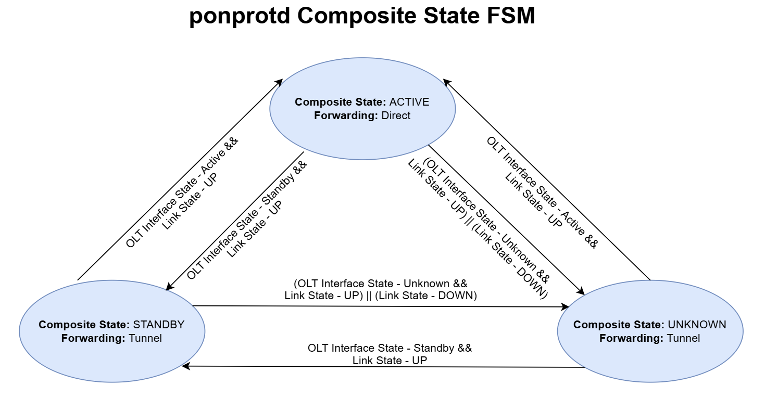
PON Protection FSM
Composite state FSM that drive the forwarding decisions:
Link State - Physical interface state (Up, Down)
OLT Interface State (Active, Standby, Unknown)
Forwarding decisions are as follows
Direct Forwarding:
Link State is UP and
OLT interface State is Active
Tunnelled:
Link State is Down or
OLT Interface State is Standby or
OLT Interface State is Unknown
Dimension | pon-protd | Key-Source
Link State | Physical Uplink State | STATE_DB:PORT_TABLE - orchagent/portsyncd
OLT Interface State | OLT Interface State | STATE_DB:PON_OLT_INTF_PROTECTION_STATE - pon-orch

Slide 10
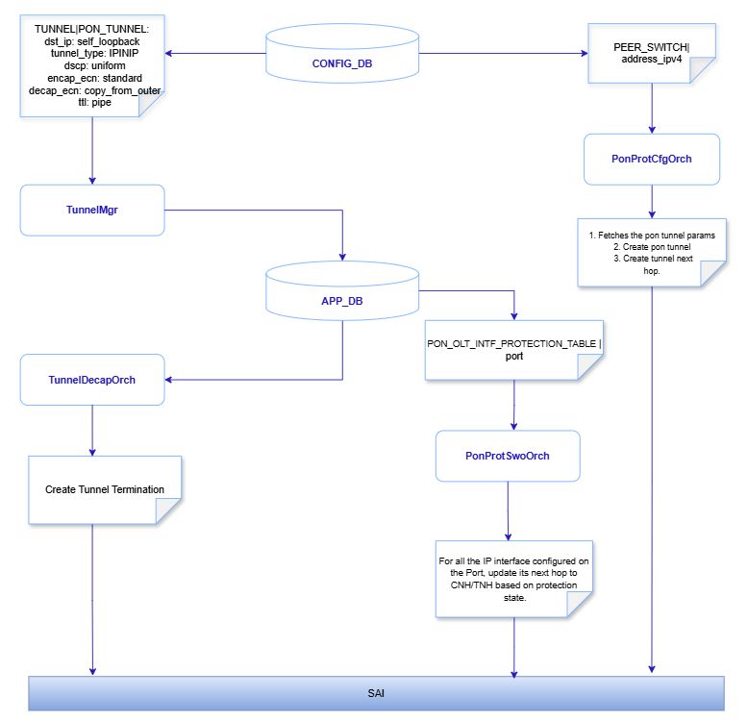
PON Protection Orchestrator
The Orchestration Agent (OrchAgent) is responsible for programming IP routes and tunnels on the Gateway to control traffic forwarding to servers/devices.
On Active state notification of the OLT Interface, the associated interface route's next hops are updated to point to the directly connected next hop
On Standby or Unknown state notification of the OLT interface, the associated interface route's next hops are updated to point to the tunnel next hop
Three orchestrator functions (highlighted) set the forwarding state of an OLT interface:
Route NH updates - switch each OLT interface routes between the connected next hop and the tunnel next hop.
Encapsulation tunnel config - programs the IPinIP encap tunnel used to reach the peer when the OLT interface is standby or unknown.
Decapsulation tunnel config - programs tunnel termination so traffic arriving from the peer is decapsulated and forwarded locally.
Decapsulation Tunnel config
Route NH updates
Encapsulation Tunnel config

Slide 11
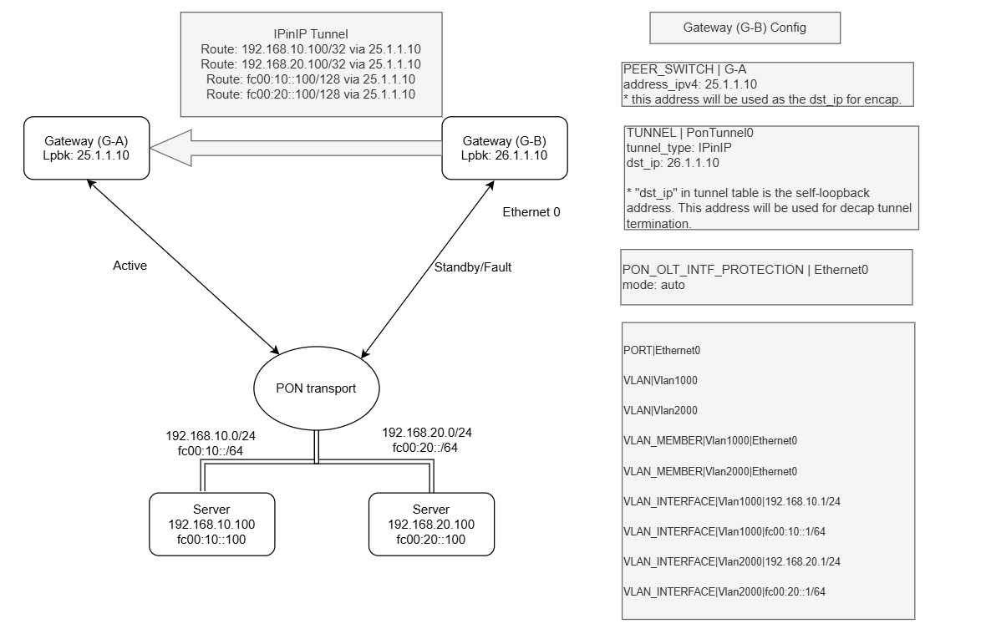
IPinIP Tunnel Programming
IPinIP Example
The diagram below provides a configuration example of Gateway (G-B) with an OLT interface in a standby state
The illustration shows the IPinIP tunnel which redirects traffic to from Gateways Router (G-B) to Gateway Router (G-A).
Neighbors that are part of the IP subnet configured on Gateway (G-B) port are redirected via the IPinIP tunnel.

Slide 12
REDIS DB Architecture
Existing tables (Reused)
DB | Table | Purpose
CONFIG_DB | BGP_DEVICE_GLOBAL | TSA drain signal (tsa_enabled)
CONFIG_DB | PEER_SWITCH | Peer Gateway IP for tunnel
APPL_DB | TUNNEL | IPinIP tunnel config
STATE_DB | PORT_TABLE | Physical link state (up/down)
New tables
DB | Table | Purpose
CONFIG_DB | PON_OLT_INTF_PROTECTION | Protection instance config (port, mode)
STATE_DB | PON_OLT_INTF_PROTECTION_STATE | OLT interface role (active/standby/unknown)
APPL_DB | PON_OLT_INTF_PROTECTION_TABLE | Forwarding intent via composite state FSM
STATE_DB | HW_PON_OLT_INTF_PROTECTION_TABLE | HW ACK after SAI route programming
STATE_DB | PON_OLT_INTF_PROTECTION_RT_TABLE | Control-plane view: composite state, health
STATE_DB | PON_OLT_INTF_PROTECTION_METRICS_TABLE | Per-port switchover count and timestamps
APPL_DB | PON_OLT_INTF_PROTECTION_SWITCH_CMD | TSA drain command (enable/disable)

Slide 13

Failover Sequence for OLT Fault
Device-1
Router A
OLT (Router A): PON Detection/Notification
Fiber (Tx/Rx) between Splitter and OLT fault
OLT detects port fault
OLT notifies Router of state change
OLT (Router B): PON Detection/Notification
OLT detects PON activity
OLT State changes to Active
OLT notifies Router of state change to Active
…
ONU-1
1
2
Device-N
IP
IP
OLT Interface Active
IP
Device-1
3
…
ONU-2
Splitter
Network
Device-N
Router B
…
4
5
IP
IP
Device-1
OLT Interface Standby
IP
…
ONU-N
6
Device-N
Router A: Detection/Switchover
OLT Interface Active → Standby state change (pon-syncd)
STATE_DB state Notification. (pon-protd)
APPL_DB state change Notification: (pon-orch).
All Host connected via the Direct Route are redirected over IPinIP Tunnel
Router B: Detection/Switchover
OLT Interface Standby → Active state change (pon-syncd)
STATE_DB state Notification. (pon-protd)
APPL_DB state change Notification: (pon-orch).
All Host connected via the IPinIP tunnel are redirected over Direct Route on newly active PON Interface
Router A
…
Device-1
7
8
ONU-1
IP
Device-N
OLT Interface Active
IP
IP
9
Device-1
…
ONU-2
Splitter
Network
Device-N
Router B
…
10
11
IP
IP
Device-1
OLT Interface Standby
IP
…
ONU-N
12
Device-N

Slide 14
Traffic Shift Away (TSA) Event
Device-1
Router A
OLT (Router A): TSA Event
TSA Event is triggered: STATE_DB change notification (pon-protd)
PON protection switch request Active → Standby send to OLT
OLT interface notifies router of state change
OLT (Switch B): PON Detection/Notification
OLT detects PON activity
OLT State changes to Active
OLT notifies router of state change
…
ONU-1
2
1
Device-N
IP
IP
OLT Interface Active
IP
Device-1
3
…
ONU-2
Splitter
Network
Device-N
Router B
…
4
5
IP
IP
Device-1
OLT Interface Standby
IP
…
ONU-N
6
Device-N
Router A: Detection/Switchover
OLT Interface Active → Standby state change (pon-syncd)
STATE_DB state Notification. (pon-protd)
On APPL_DB state change Notification: (pon-orch).
All Host connected via the Direct Route are redirected over IPinIP Tunnel
Router B: Detection/Switchover
OLT Interface Standby → Active state change (pon-syncd)
STATE_DB state Notification. (pon-protd)
APPL_DB state change Notification: (pon-orch).
All Host connected via the IPinIP tunnel are redirected over Direct Route
Device-1
Router A
…
ONU-1
7
8
Device-N
IP
IP
OLT Interface Active
9
IP
Device-1
…
ONU-2
Splitter
Network
Device-N
Router B
…
10
11
IP
IP
Device-1
OLT Interface Standby
IP
…
ONU-N
12
Device-N

Slide 15
Memory Footprints
Note: No memory required unless PON is activated on the platform.
Memory on the Gateway switches grows linearly with the number of configured OLT interface protection instances, the number of IP subnets per port, and the number of ONUs and servers attached.
The table below uses a single OLT interface and a single server IP as the unit basis.
Total consumption at any scale can be derived by extrapolating the numbers.
Scale formula is derived as follows
N OLT ports with S subnets per OLT port
Total Footprint = 15 MB​​ (pon-protd fixed) + (N * 4.6 KB) + (N * S * 1 KB)
These numbers are incremental - they are in addition to the memory footprint described in the PON HLD for configuring OLTs and ONUs on SONiC.
Component | Fixed (one-time) | Per OLT Interface | Per Server IP
pon-protd | ~15-20 MB | ~1.5 KB
dcpon-syncd |  | ~1 KB
pon-prot-orch |  | ~1 KB | ~400 bytes
REDIS (new keys) |  | ~1.1 KB
ASIC route entries |  |  | ~300 bytes
Total | ~15-20 MB | ~4.6 KB | 700 bytes (~1 KB)

Slide 16
How to test?
Dual Homed PON Gateway solution creates two containers:
docker-pon-manager — vendor agnostic; houses pon-mgrd and ponprotd
docker-pon-syncd — vendor specific; houses dcpon-syncd and loads the vendor PON SAI extension (similar to gearbox model)
Simulator testing uses only docker-pon-manager — no vendor SAI needed
Simulator Testing (VM-based):
Boot SONiC VM and deploy 'docker-pon-manager' manually
Provision OLT interfaces, ONUs and protection instances via CLI or CONFIG_DB
Inject OLT state directly via Redis:
sonic-db-cli STATE_DB HSET 'PON_OLT_INTF_PROTECTION_STATE|Ethernet0' olt_intf_state active
FSM activates — verify composite state and forwarding entries:
sonic-db-cli STATE_DB HGETALL 'PON_OLT_INTF_PROTECTION_RT_TABLE|Ethernet0'
Simulate OLT failure — inject Active → Standby/Unknown transition:
sonic-db-cli STATE_DB HSET 'PON_OLT_INTF_PROTECTION_STATE|Ethernet0' olt_intf_state standby
Hardware Testing (Real OLT plugs required):
Insert and configure OLT plugs — 'dcpon-syncd' detects state via vendor SDK
Software reacts automatically to OLT state changes driven by the hardware
Pull or admin-down an OLT plug to exercise failover

Slide 17
Troubleshooting
REASON field explaining the drift in composite state FSM
HEALTH index representing the desired system state
SHOW status/detail output are visible once OLT interface is operational
REDIS CLI checks to confirm port admin status and OLT interface dependencies that drive APPL_DB/STATE_DB population
TELEMETRY gives you a real-time snapshot of control-plane and runtime behaviour. Key telemetry to track includes:
Operational state - state, direction, reason, state_change_time
Runtime inputs - olt_intf_state, link_state, tsa_active
Computed outputs - composite_state, health
Optional/placeholder views - switchover_start, switchover_end, switchover_count, role_switch_cmd
SYSLOG explains why transitions occurred and whether updates were applied, skipped, or suppressed:
Startup and initialization - instance discovery, TSA initialization, subscription setup
Runtime transitions - link state updates, OLT interface state updates, FSM activation
Stability/failure signals - select errors, thread exceptions, shutdown/signal handling
CLIs:
show pon protection olt-interface
show pon protection olt-interface state
show pon protection olt-interface detail <Ethernet1>

Slide 18
Q&A
Thank You

